Slide 1

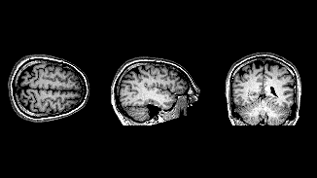
Classifying Brain Tumor Segmentation With CNN
By Jacob Heyman

Slide 2


Overview
11,700 brain tumors diagnosed each year
Early detection is key for higher survival rates
Different types of brain tumors have different pathologies
Diagnosis is done with visual analysis

Slide 3

Business Problem
Hundreds of Images produced for each patient
1
Images require visual analysis from multiple experts
2
Quality analysis is not globally accessible
3
Human Error
4

Slide 4
Research Questions
Can We Create a Model to Classify the different tumor types?
What Model and Method best reduces false negatives?
What are the key features of our tumor classes?

Slide 5
DAta
Kaggle Brain Tumor Image Dataset
Train and Test image files
Four Classes
Glioma
Meningioma
No Tumor
Pituitary

Slide 6
Methods

Slide 7
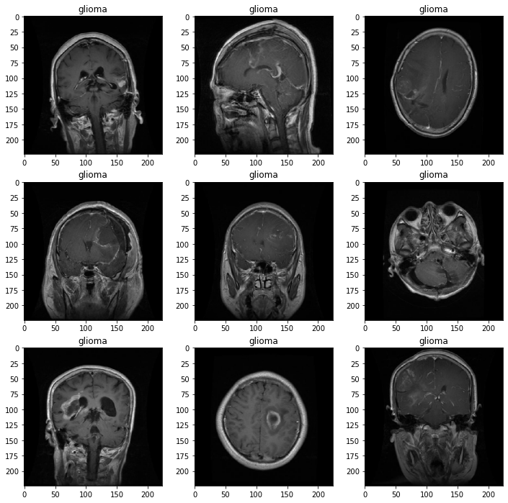
Key Features Glioma Tumors
Some Hyper intensive
Some isointense
Cancer of Glial Cells
Asymmetry

Slide 8
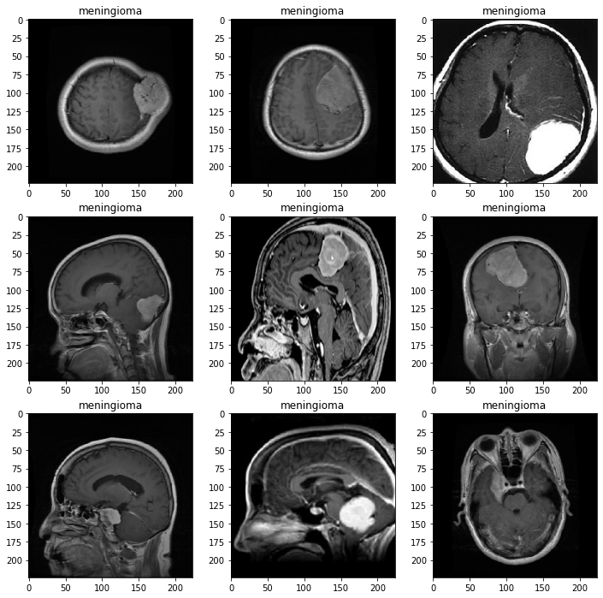
Key Features Meningioma Tumors
Cancer in meninges
Tumor is located between the brain and the skull
Hyperintense on MRI images

Slide 9
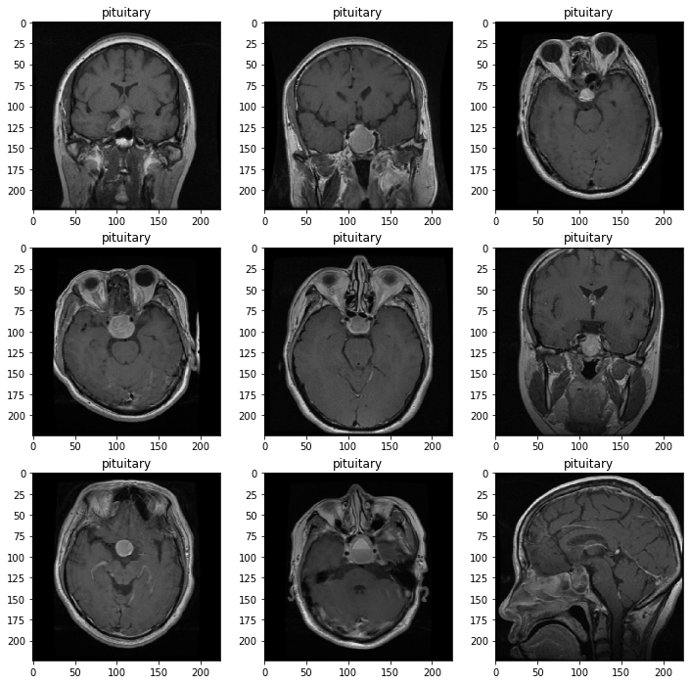
Key Features Pituitary Tumors
Tumor in the Pituitary gland
Same Location in every image
Hyper intensive

Slide 10
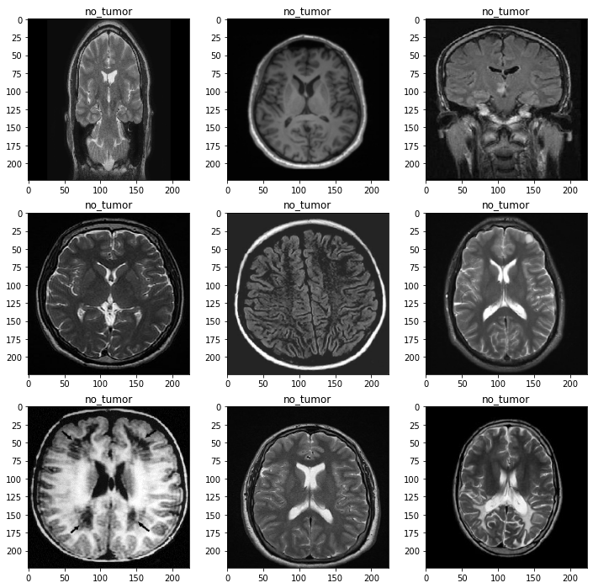
Key Features No Tumors
Symmetrical
Isointense
Control Class

Slide 11
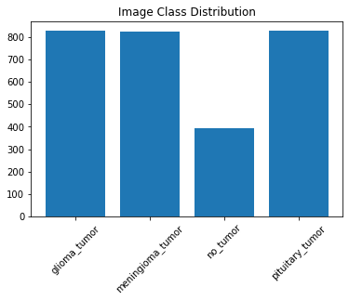
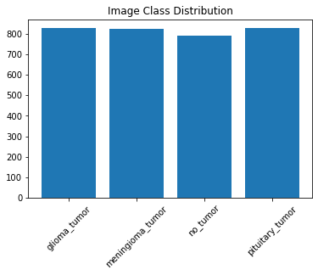
Data Augmentation
Created a balanced dataset
Added horizontal flip images to No Tumor Class

Slide 12
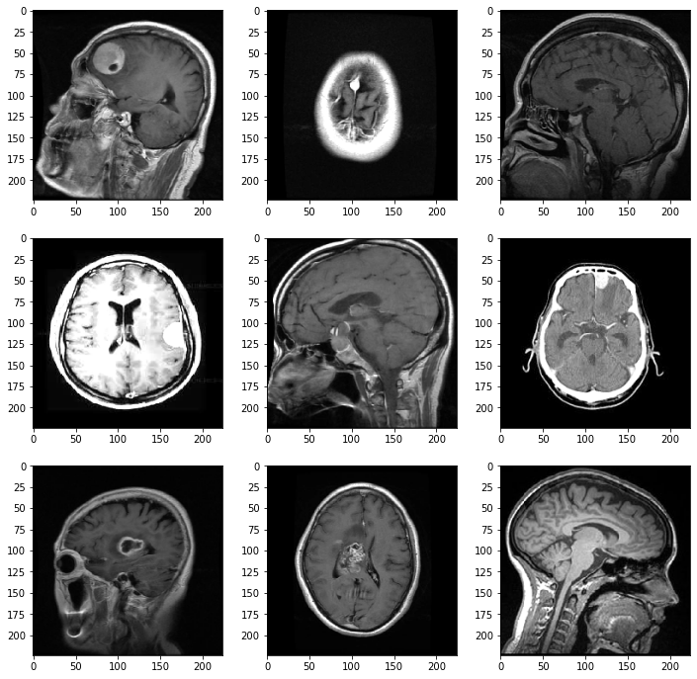
Data Augmentation
Brightened Range of Images
Brightened 0% to 60%
Doubled Image DataSet

Slide 13
Modeling Process
Baseline Models
Simple CNN with 2 Convolutional Layers and MaxPooling
Complex CNN
AlexNet Architecture
Experimental CNN 2 with 4 Convolutional Layers, MaxPooling and dropout
Experimental CNN 1 with 3 Convolutional layers, 1 MaxPooling 2 AveragePooling
3 Datasets
Unaltered
Balanced
Brightened

Slide 14
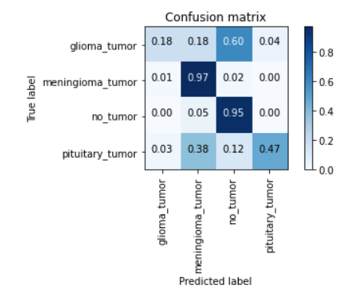
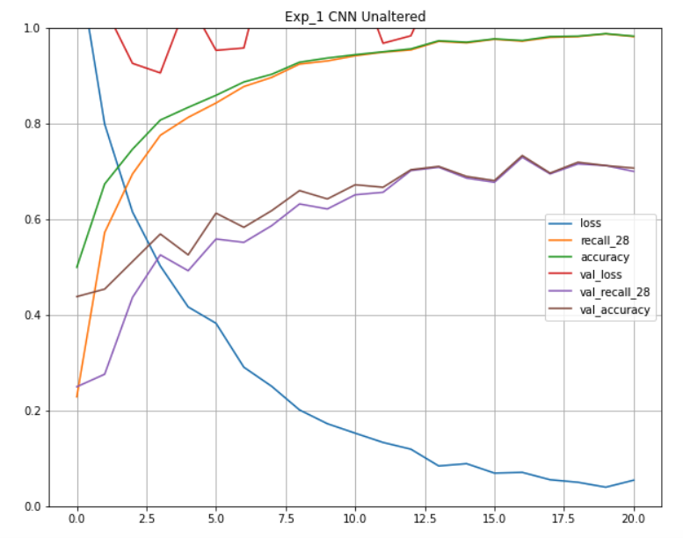
Best Test Score
Accuracy: 70%
Recall: 69%

Slide 15
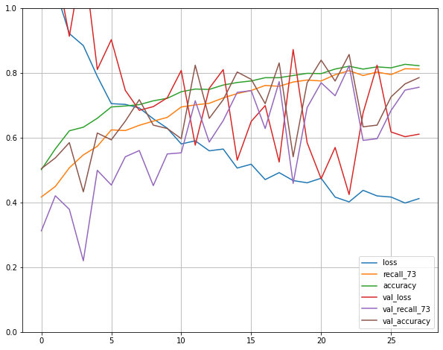
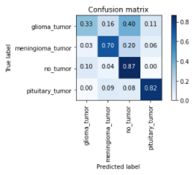
Best TRUE POSITIVES
Accuracy: 67.5%
Recall: 60%

Slide 16
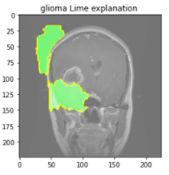
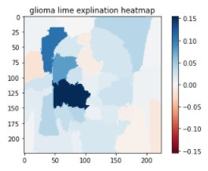
True Positive Glioma Key Featrues

Slide 17
Conclusion
Highest Accuracy 70% and Highest Recall 69%
Brightened Data: Lower Metrics Better Positives
Predicting on Asymmetry for Glioma
Difficulty classifying Glioma and Pituitary Tumors
Highest True Positives for Pituitary Tumors
Interesting False negatives for Meningiomas and no tumor class
Further augmentation may be needed to boost glioma classification

Slide 18
Next Steps
Zoom and Flip
Zoom and Flip glioma images with image augmentation
Reduce
Reduce Brightness Range for Brightened dataset and include darkened images
Tune
Tune the AlexNet to address overfitting

Slide 19
Thank YOU
https://github.com/Jacobheyman702/Brain_tumor_classifer
https://rsna2020.rsna.org/
https://www.kaggle.com/sartajbhuvaji/brain-tumor-classification-mri

